Slide 1
Machine Learning and Meta-Learning

Slide 2
Keywords for machine learning
EXPERIENCE
EVALUATION
CHANGE
OBJECTIVENESS (LOSS)
SUPERVISED (FUNCTION)
UNSUPERVISED (DISTRIBUTION, ASSOCIATE RULE)
OPTMIZATION (SEARCH)
OVERFITTING (GENERALIZATION)
REINFORCEMENT
REPRESENTATION (OBJECT)

Slide 3
Keywords for artificial neural network
FUNCTION
STRUCTURE
NEURON
FEEDFORWARD
SELF-ORANIZING FEATURE MAP
MULTI-LAYER PERCEPTION
FEEDBACK (RECURRENT)
BACK-PROPAGATION (BP)
RADIAL BASIS FUNCTION
DEEP

Slide 4
AI system with learning and meta-learning

Slide 5
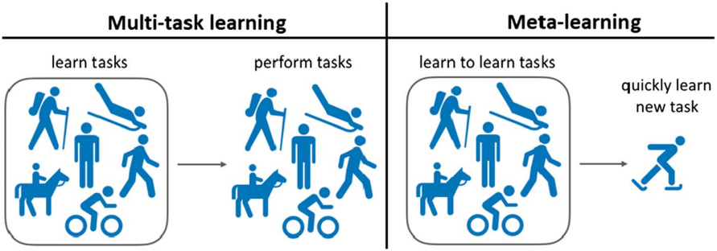
What is Meta-Learning？
Meta-learning agents improve their learning ability over time, or equivalently, learn to learn.
Inner-level, learn to adapt to a single task
Outer-level, learn to learn, for adapting to a multitude of tasks.

Slide 6
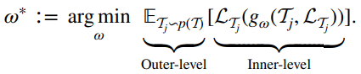
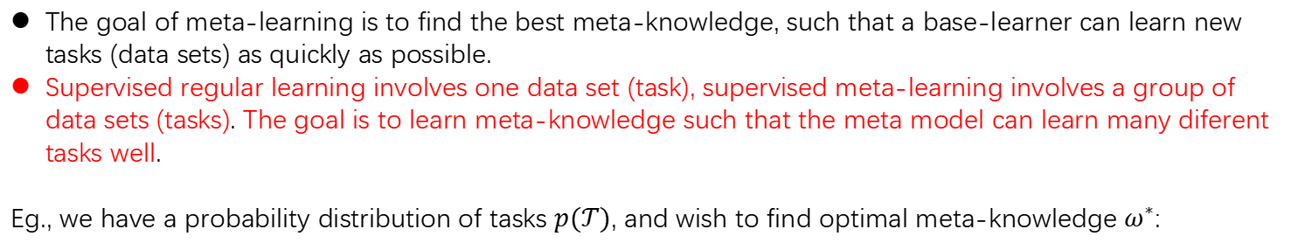
How to Meta-Learning？-supervised learning
The goal of meta-learning is to find the best meta-knowledge, such that a base-learner can learn new tasks (data sets) as quickly as possible.
Supervised regular learning involves one data set (task), supervised meta-learning involves a group of data sets (tasks). The goal is to learn meta-knowledge such that the meta model can learn many diferent tasks well.
Eg., we have a probability distribution of tasks $p(𝒯)$, and wish to find optimal meta-knowledge $ω^{∗}$:

Slide 7
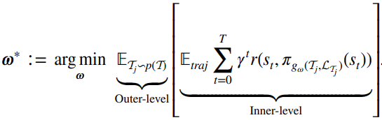
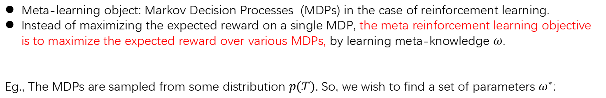
How to Meta-Learning？-reinforcement learning
Meta-learning object: Markov Decision Processes (MDPs) in the case of reinforcement learning.
Instead of maximizing the expected reward on a single MDP, the meta reinforcement learning objective is to maximize the expected reward over various MDPs, by learning meta-knowledge $ω$.
Eg., The MDPs are sampled from some distribution $p(𝒯)$. So, we wish to find a set of parameters $ω^{∗}$:

Slide 8
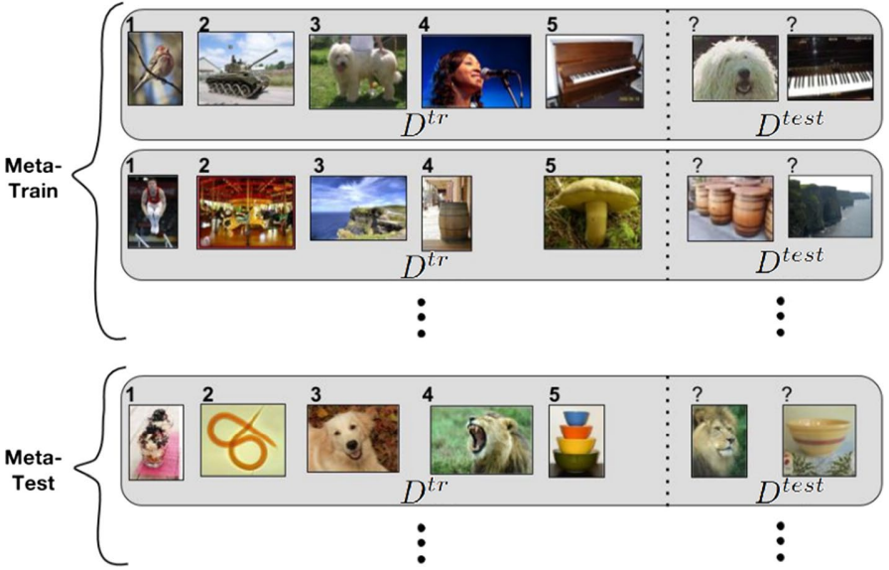
How to Meta-Learning？
1 meta-train stage: the base learner is optimized with the meta-train datasets (D^{tr} of Meta-Train). (inner-level)
2 meta-validation stage: the meta-validation datasets (D^{test} of Meta-Train) are used to evaluate the performance on unseen tasks. Effectively, this measures the meta-generalization ability, for tuning the meta model. (outer-level)
3 meta-test stage: give a final performance estimate of the meta-learning method.

Slide 9
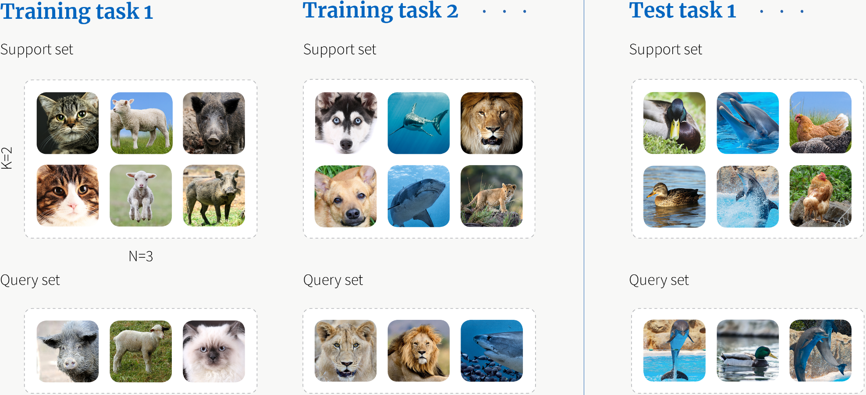
Learning Task Sampling

Slide 10
Meta-Learning’s optimization, representation and application

Slide 11
Overview of Meta-Learning
 | Metric- | Model- | Optimization-
Key idea | Input similarity | Internal task representation | Optimize for fast adaptation
Advantage | Simple and effective | Flexible | More robust generalizability

Slide 12
Metric based Meta-Learning

Slide 13
Approaches
Name | key-idea | category
Siamese networks | Two-input, shared-weight, class identity network | Metric-
Matching networks | Learn input embeddings for cosine-similarity weighted predictions
Prototypical networks | input embeddings for class prototype clustering
Relation networks | learn input embeddings and similarity metric
Attentive Recurrent Comparators | LSTM-based input fusion through interleaved glimpses

Slide 14
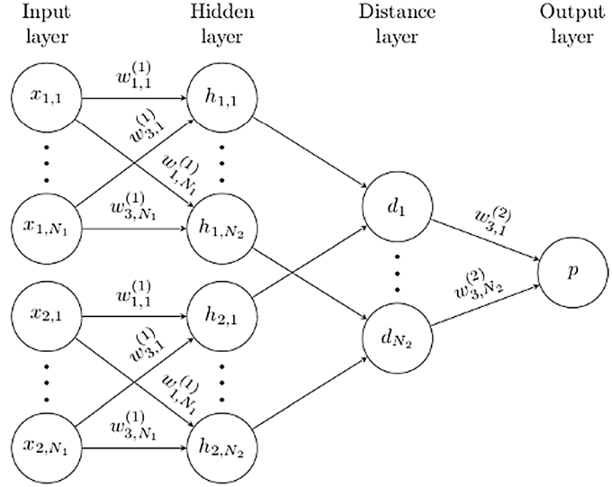
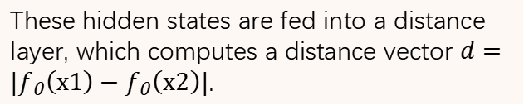
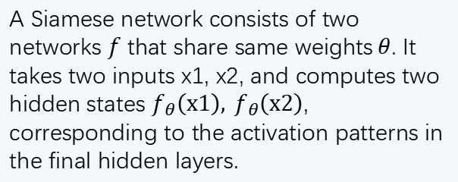
Metric-based Siamese network
A Siamese network consists of two networks $f$ that share same weights$θ$. It takes two inputs x1, x2, and computes two hidden states $f_{θ}\left(x1\right), f_{θ}\left(x2\right)$, corresponding to the activation patterns in the final hidden layers.
These hidden states are fed into a distance layer, which computes a distance vector $d=|f_{θ}\left(x1\right)−f_{θ}\left(x2\right)|$.

Slide 15
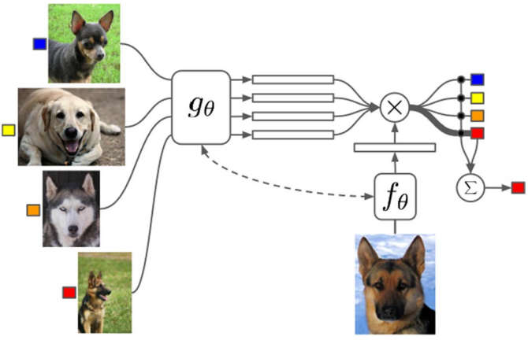
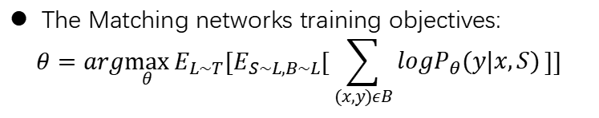
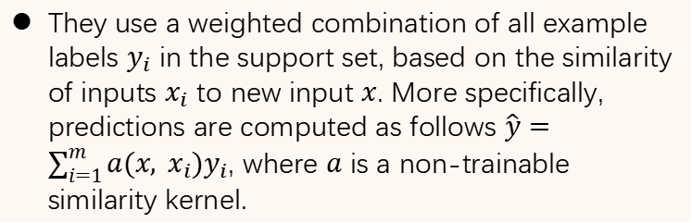
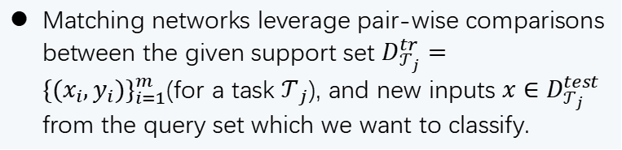
Metric-based Matching networks
Matching networks leverage pair-wise comparisons between the given support set $D_{𝒯_{j}}^{tr}={\{(x_{i},y_{i})\}}_{i=1}^{m}$(for a task $𝒯_{j}$), and new inputs $x∈D_{𝒯_{j}}^{test}$ from the query set which we want to classify.
They use a weighted combination of all example labels $y_{i}$ in the support set, based on the similarity of inputs $x_{i}$ to new input $x$. More specifically, predictions are computed as follows $\hat{y}=\sum_{i=1}^{m}{a(x, x_{i})y_{i}}$, where $a$ is a non-trainable similarity kernel.
The Matching networks training objectives:
$$θ=arg\max_{θ}{E_{L\sim T}[E_{S\sim L,B\sim L}[\sum_{(x,y)εB}{logP_{θ}(y|x,S)}]]}$$

Slide 16
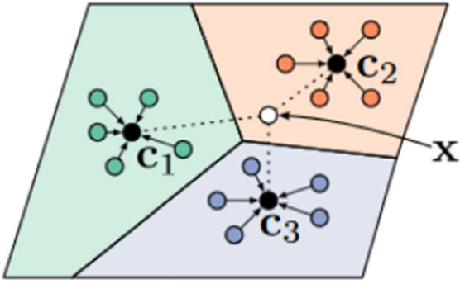
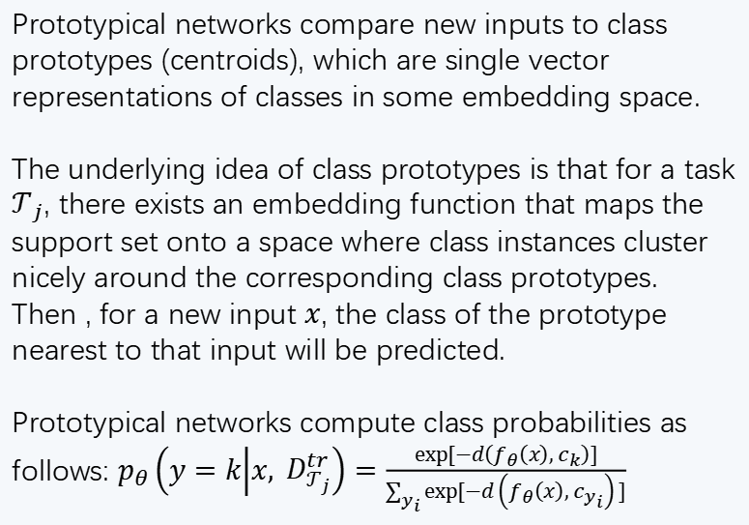
Metric-based Prototypical networks
Prototypical networks compare new inputs to class prototypes (centroids), which are single vector representations of classes in some embedding space.
The underlying idea of class prototypes is that for a task $𝒯_{j}$, there exists an embedding function that maps the support set onto a space where class instances cluster nicely around the corresponding class prototypes. Then , for a new input $x$, the class of the prototype nearest to that input will be predicted.
Prototypical networks compute class probabilities as follows: $p_{θ}\left(y=k | x, D_{𝒯_{j}}^{tr}\right)=\frac{exp⁡[−d\left(f_{θ}\left(x\right), c_{k}\right)]}{\sum_{y_{i}}{exp⁡[}−d\left(f_{θ}\left(x\right), c_{y_{i}}\right)]}$

Slide 17
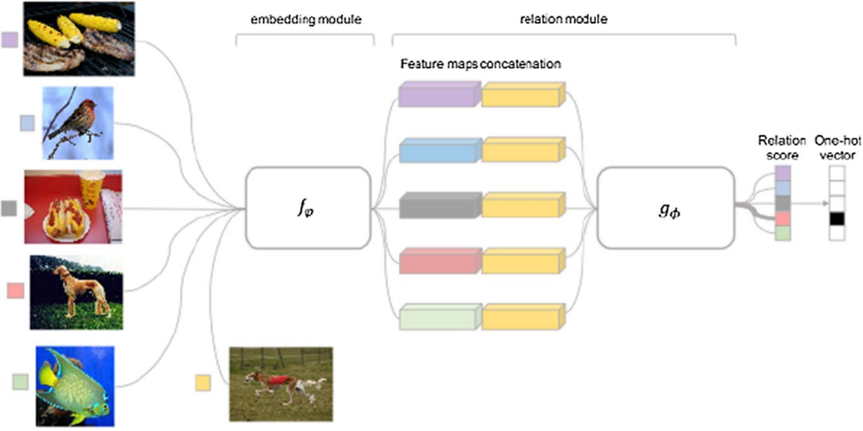
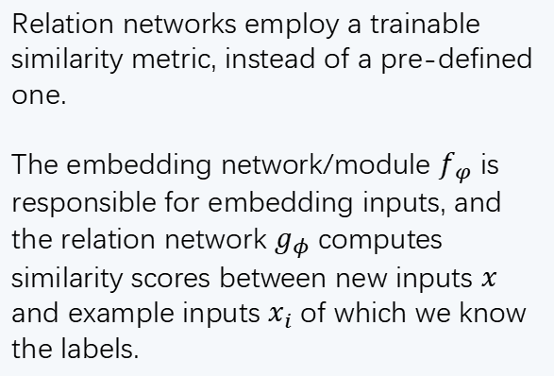
Metric-based Relation networks
Relation networks employ a trainable similarity metric, instead of a pre-defined one.
The embedding network/module $f_{φ}$ is responsible for embedding inputs, and the relation network $g_{φ}$ computes similarity scores between new inputs $x$ and example inputs $x_{i}$ of which we know the labels.

Slide 18
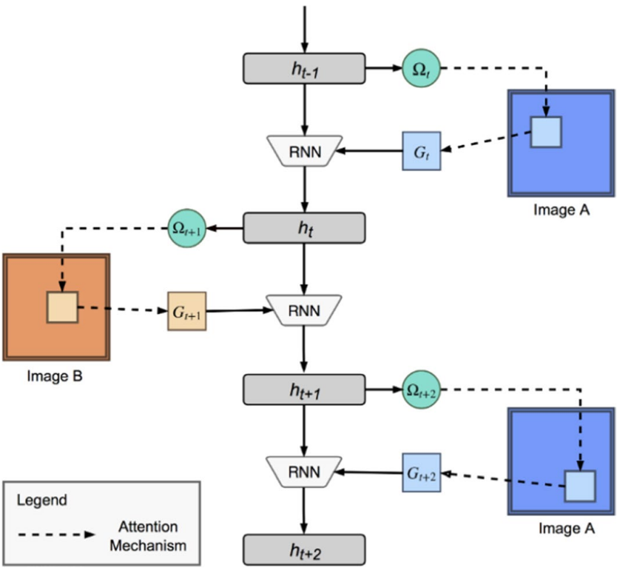
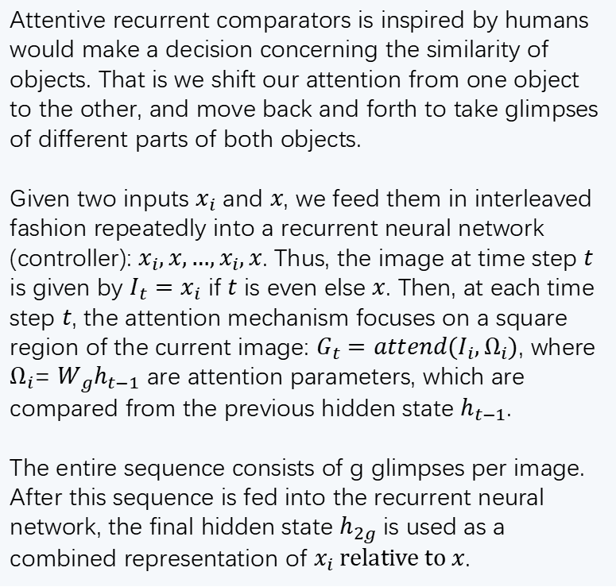
Metric-based Attentive recurrent comparators
Attentive recurrent comparators is inspired by humans would make a decision concerning the similarity of objects. That is we shift our attention from one object to the other, and move back and forth to take glimpses of different parts of both objects.
Given two inputs $x_{i}$ and $x$, we feed them in interleaved fashion repeatedly into a recurrent neural network (controller): $x_{i},x,…,x_{i},x$. Thus, the image at time step $t$ is given by $I_{t}=x_{i}$ if $t$ is even else $x$. Then, at each time step $t$, the attention mechanism focuses on a square region of the current image: $G_{t}=attend(I_{i},Ω_{i})$, where $Ω_{i}$= $W_{g}h_{t−1}$ are attention parameters, which are compared from the previous hidden state $h_{t−1}$.
The entire sequence consists of g glimpses per image. After this sequence is fed into the recurrent neural network, the final hidden state $h_{2g}$ is used as a combined representation of $x_{i} relative to x$.

Slide 19
Metric-based Conclusions
The metric-based techniques meta-learn an informative feature space and similarity measure that can be used to compute class predictions based on input similarity scores.
Key advantages of these metric-based techniques are that (i) the underlying idea of similarity-based predictions is conceptually simple, and (ii) they can be fast at test-time when tasks are small, as the networks do not need to make task-specific adjustments. However, when tasks at meta-test time become more distant from the tasks that were used at meta-train time, metric-learning techniques are unable to absorb new task information into the network weights. Consequently, performance may sufer.
When tasks become larger, pair-wise comparisons may become computationally expensive. Lastly, most metric-based techniques rely on the presence of labeled examples, which make them inapplicable outside of supervised learning settings.

Slide 20
Model-based Meta-Learning

Slide 21
Approaches
Name | key-idea | category
Recurrent meta-learning | Deploy Recurrent networks as meta-model | Model-
MANNs | External short-term memory module for fast learning
Meta networks | Fast reparameterization of base-learner by distinct meta-learner
SNAIL | Attention mechanism coupled with temporal convolutions
CNP | Condition predictive model on embedded contextual task data
Neural statistician | Similarity between latent task embeddings

Slide 22
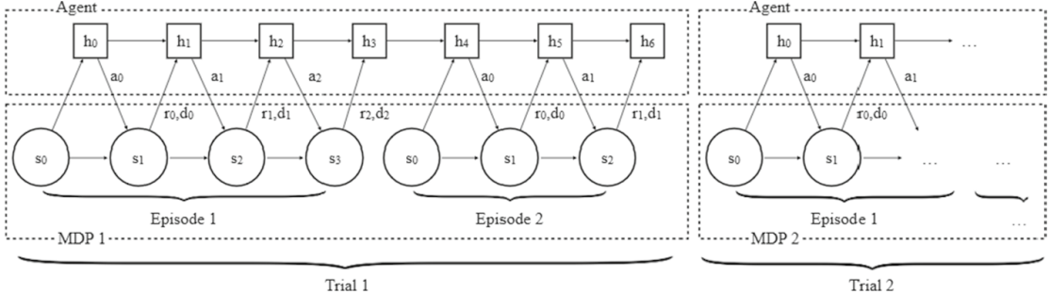
Model-based Recurrent meta-learning
Recurrent meta-learners serves as dynamic task embedding storage.
The internal dynamics of the chosen RNN allows for fast adaptation to new tasks, while the algorithm used to train the RNN gradually accumulates knowledge about the task structure
Given a task, the environmental variables (state, action, reward, termination flag, etc.) fed into an RNN at every time step. Then, the RNN outputs an action and a hidden state. The goal of meta-learning is to maximize the expected reward in each trial.

Slide 23
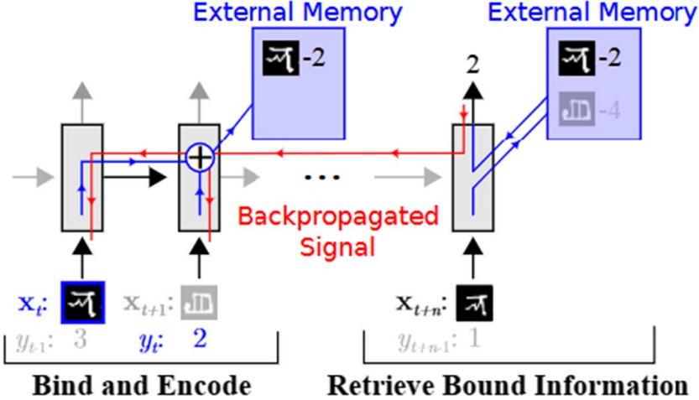
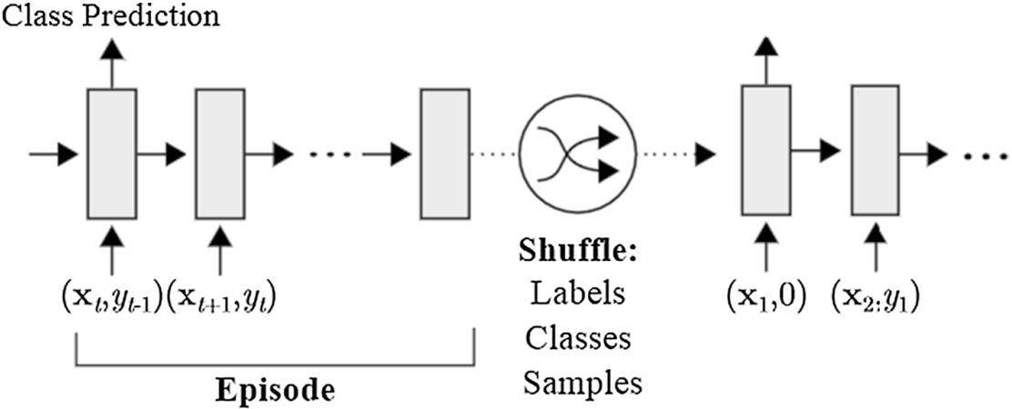
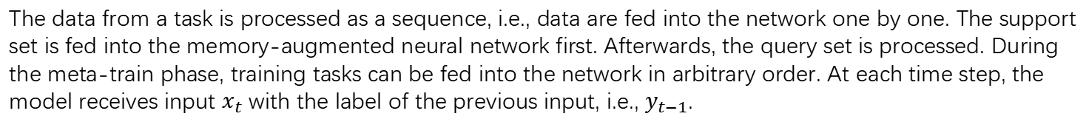
Model-based MANNs-1
The key idea of memory-augmented neural networks (MANNs) is to enable neural networks to learn quickly with the help of an external memory.
The data from a task is processed as a sequence, i.e., data are fed into the network one by one. The support set is fed into the memory-augmented neural network first. Afterwards, the query set is processed. During the meta-train phase, training tasks can be fed into the network in arbitrary order. At each time step, the model receives input $x_{t}$ with the label of the previous input, i.e., $y_{t−1}$.

Slide 24
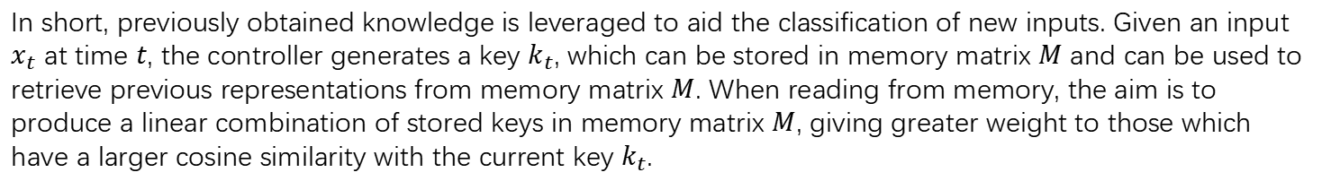
Model-based MANNs-2
In short, previously obtained knowledge is leveraged to aid the classification of new inputs. Given an input $x_{t}$ at time $t$, the controller generates a key $k_{t}$, which can be stored in memory matrix $M$ and can be used to retrieve previous representations from memory matrix $M$. When reading from memory, the aim is to produce a linear combination of stored keys in memory matrix $M$, giving greater weight to those which have a larger cosine similarity with the current key $k_{t}$.

Slide 25
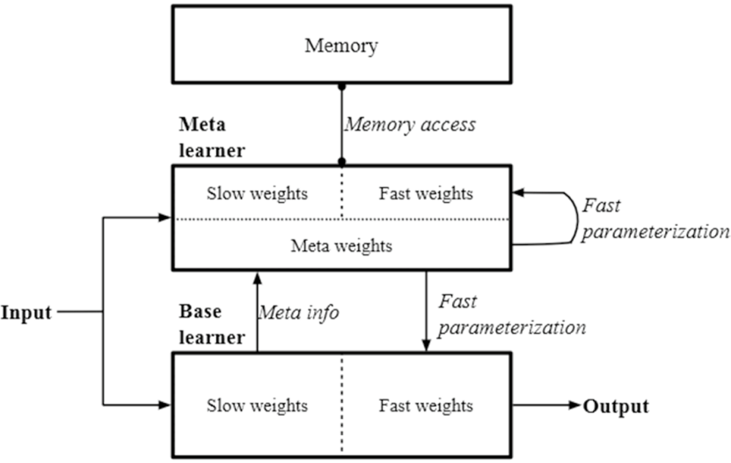
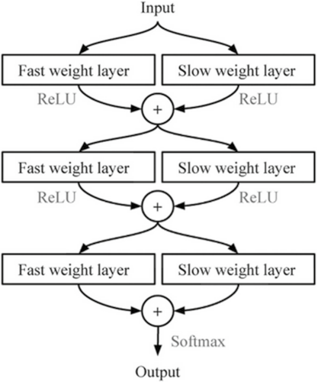
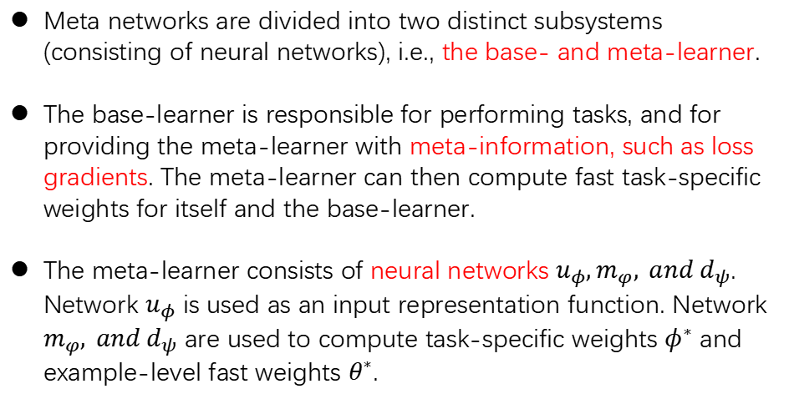
Model-based Meta networks-1
Meta networks are divided into two distinct subsystems (consisting of neural networks), i.e., the base- and meta-learner.
The base-learner is responsible for performing tasks, and for providing the meta-learner with meta-information, such as loss gradients. The meta-learner can then compute fast task-specific weights for itself and the base-learner.
The meta-learner consists of neural networks $u_{φ},m_{φ}, and d_{ψ}$. Network $u_{φ}$ is used as an input representation function. Network $m_{φ}, and d_{ψ}$ are used to compute task-specific weights $φ^{∗}$ and example-level fast weights $θ^{∗}$.

Slide 26
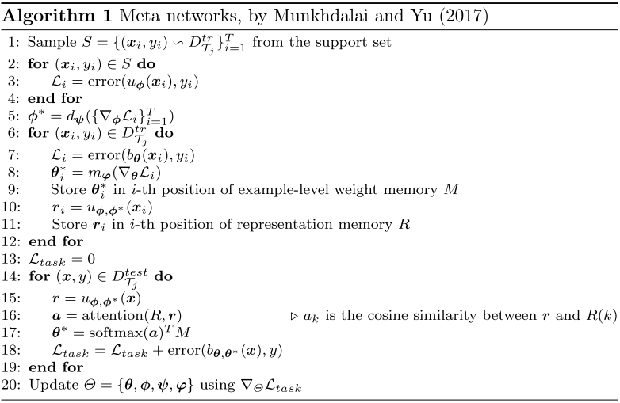
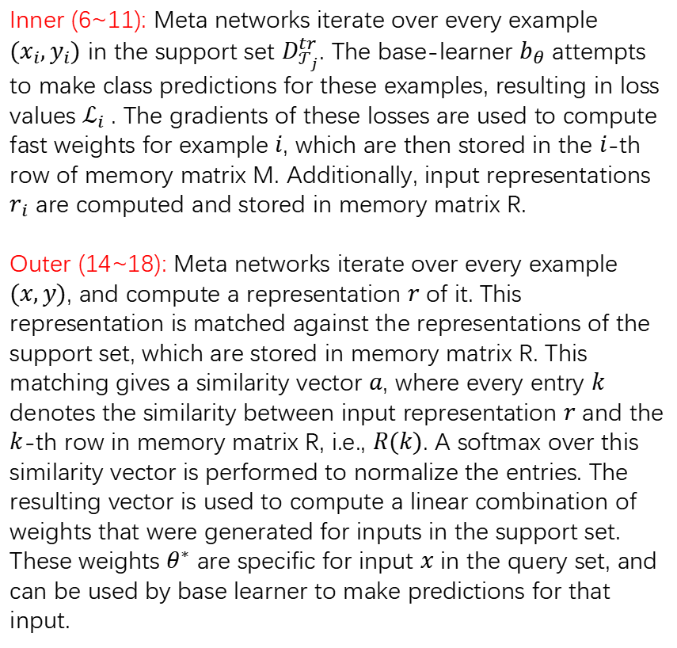
Model-based Meta networks-2
Inner (6~11): Meta networks iterate over every example $(x_{i},y_{i})$ in the support set $D_{𝒯_{j}}^{tr}$. The base-learner $b_{θ}$ attempts to make class predictions for these examples, resulting in loss values $ℒ_{i}$ . The gradients of these losses are used to compute fast weights for example $i$, which are then stored in the $i$-th row of memory matrix M. Additionally, input representations $r_{i}$ are computed and stored in memory matrix R.
Outer (14~18): Meta networks iterate over every example $(x,y)$, and compute a representation $r$ of it. This representation is matched against the representations of the support set, which are stored in memory matrix R. This matching gives a similarity vector $a$, where every entry $k$ denotes the similarity between input representation $r$ and the $k$-th row in memory matrix R, i.e., $R(k)$. A softmax over this similarity vector is performed to normalize the entries. The resulting vector is used to compute a linear combination of weights that were generated for inputs in the support set. These weights $θ^{∗}$ are specific for input $x$ in the query set, and can be used by base learner to make predictions for that input.

Slide 27
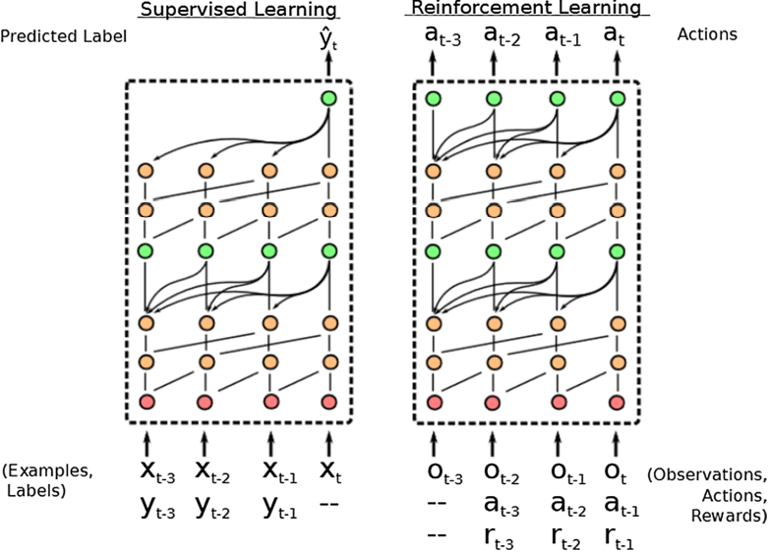
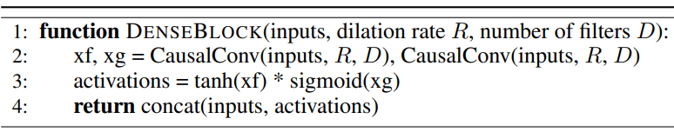
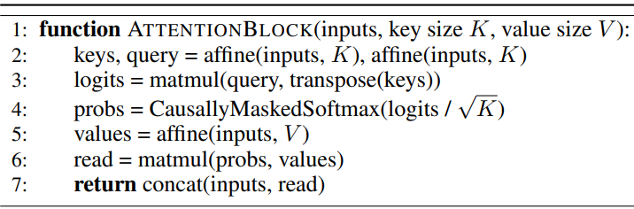
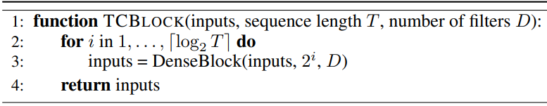
Model-based Simple neural attentive meta-learner (SNAIL)
SNAIL consists of three building blocks. The first is the DenseBlock, which applies a single 1D convolution to the input, and concatenates the result. The second is a TCBlock (Temporal convolutions), which is simply a series of DenseBlocks with an exponentially increasing dilation rate of the temporal convolutions. Note that the dilation is nothing but the temporal distance between two nodes in a network. The third block is the AttentionBlock, which learns to focus on the important parts of prior experience.
in this example, two blocks of TC layers (orange) are interleaved with two causal attention layers (green).

Slide 28
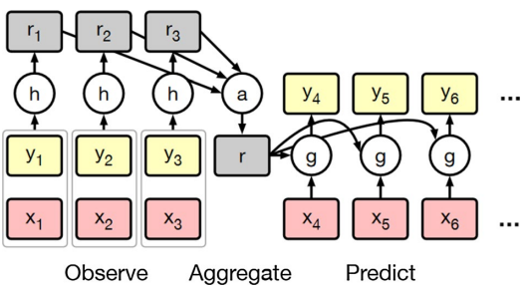
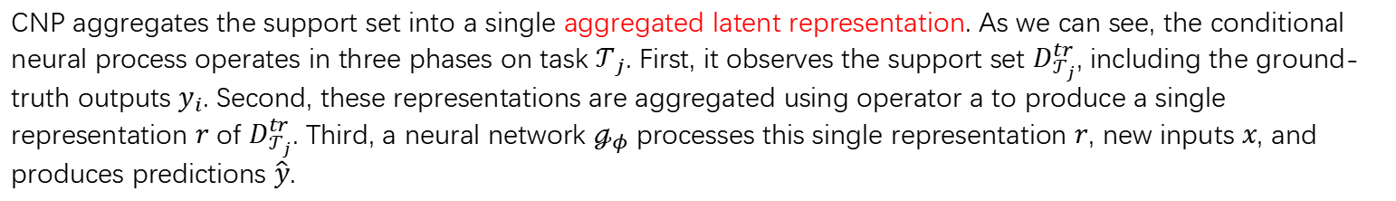
Model-based Conditional neural processes (CNP)
CNP aggregates the support set into a single aggregated latent representation. As we can see, the conditional neural process operates in three phases on task $𝒯_{j}$. First, it observes the support set $D_{𝒯_{j}}^{tr}$, including the ground-truth outputs $y_{i}$. Second, these representations are aggregated using operator a to produce a single representation $r$ of $D_{𝒯_{j}}^{tr}$. Third, a neural network $ℊ_{φ}$ processes this single representation $r$, new inputs $x$, and produces predictions $\hat{y}$.

Slide 29
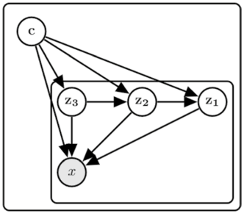
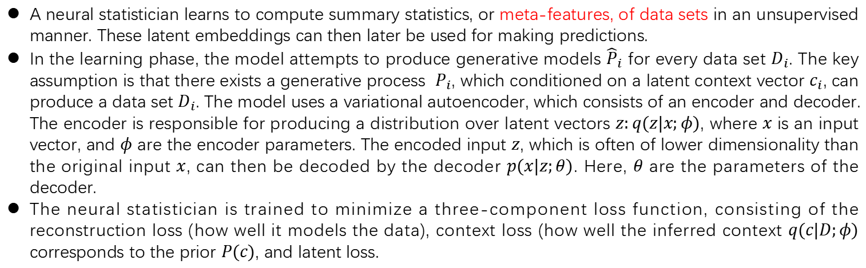
Model-based Neural statistician
A neural statistician learns to compute summary statistics, or meta-features, of data sets in an unsupervised manner. These latent embeddings can then later be used for making predictions.
In the learning phase, the model attempts to produce generative models ${\hat{P}}_{i}$ for every data set $D_{i}$. The key assumption is that there exists a generative process $P_{i}$, which conditioned on a latent context vector $c_{i}$, can produce a data set $D_{i}$. The model uses a variational autoencoder, which consists of an encoder and decoder. The encoder is responsible for producing a distribution over latent vectors $z:q(z|x;φ)$, where $x$ is an input vector, and $φ$ are the encoder parameters. The encoded input $z$, which is often of lower dimensionality than the original input $x$, can then be decoded by the decoder $p(x|z;θ)$. Here, $θ$ are the parameters of the decoder.
The neural statistician is trained to minimize a three-component loss function, consisting of the reconstruction loss (how well it models the data), context loss (how well the inferred context $q(c|D;φ)$ corresponds to the prior $P(c)$, and latent loss.

Slide 30
Model-based Conclusions
Despite apparent differences, they all build on the notion of task internalization. That is, tasks are processed and represented in the state of the model-based system. This state can then be used to make prediction.
Advantages of model-based approaches include the flexibility of the internal dynamics of the systems, and their broader applicability compared to most metric-based techniques. However, model-based techniques are often outperformed by metric-based techniques in supervised settings, may not perform well when presented with larger data sets, and generalize less well to more distant tasks than optimization-based techniques.

Slide 31
Optimization-based Meta-Learning

Slide 32
Approaches
Name | key-idea | obj | category
LSTM optimizer | RNN proposing weight updates for base-leaner | Optimizer | Optimization-
RL optimizer | View optimization as RL problem | Optimizer
MAML | Learn initialization weights for fast adaptation | Initialization
Meta-SGD | Learn both the initialization and updates | Initialization
Reptile | Move initialization towards task-specific updated weights | Initialization
LEO | Optimize in lower-dimensional latent parameter space | Optimizer
learned Objective function | Train a network as a loss function for optimizing base learner | Parametric objective function
Genetic Loss Optimization | A genetic algorithm constructs candidate loss functions as trees. The best loss functions from this set then has its coefficients optimized using CMA-ES. | the formula of objective function
Evolved policy gradients | Train a network as loss for RL for optimizing policy network | Loss of policy network
Stochastic loss function | Train a network for weighting loss functions | Objective function selection and weighting

Slide 33
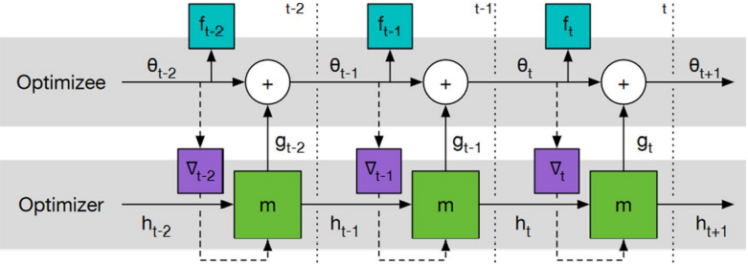
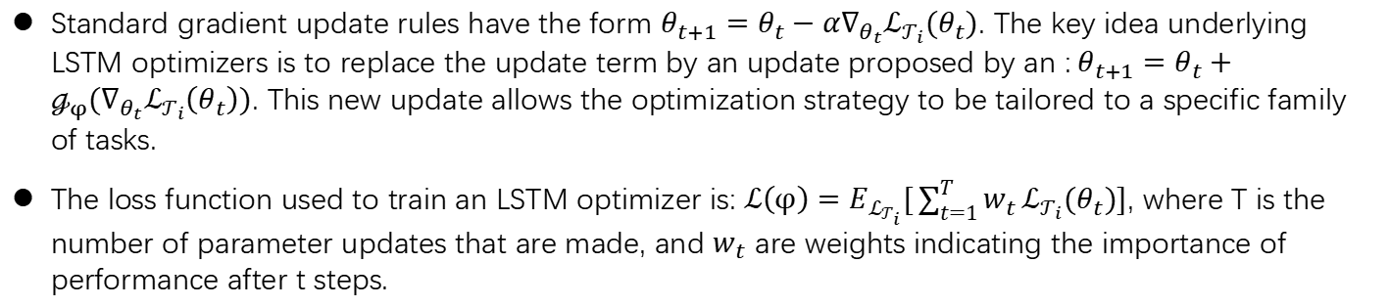
LSTM optimizer
Standard gradient update rules have the form $θ_{t+1}=θ_{t}−α∇_{θ_{t}}ℒ_{𝒯_{i}}(θ_{t})$. The key idea underlying LSTM optimizers is to replace the update term by an update proposed by an :$θ_{t+1}=θ_{t}+ℊ_{φ}(∇_{θ_{t}}ℒ_{𝒯_{i}}\left(θ_{t}\right))$. This new update allows the optimization strategy to be tailored to a specific family of tasks.
The loss function used to train an LSTM optimizer is: $ℒ\left(φ\right)=E_{ℒ_{𝒯_{i}}}[\sum_{t=1}^{T}{w_{t}}ℒ_{𝒯_{i}}(θ_{t})]$, where T is the number of parameter updates that are made, and $w_{t}$ are weights indicating the importance of performance after t steps.

Slide 34
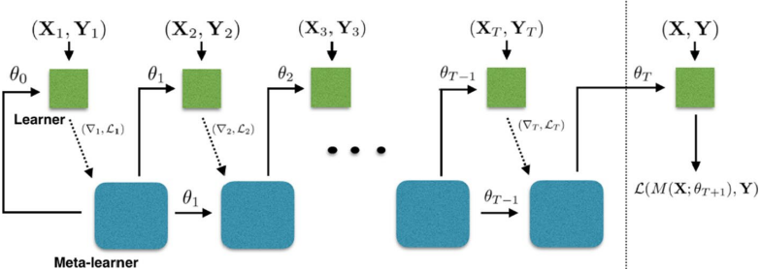
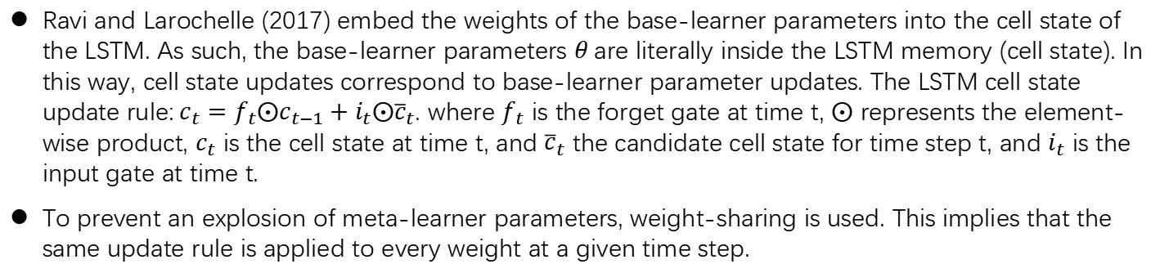
LSTM meta-learner
Ravi and Larochelle (2017) embed the weights of the base-learner parameters into the cell state of the LSTM. As such, the base-learner parameters $θ$ are literally inside the LSTM memory (cell state). In this way, cell state updates correspond to base-learner parameter updates. The LSTM cell state update rule:$c_{t}=f_{t}⨀c_{t−1}+i_{t}⨀{\overline{c}}_{t}$. where $f_{t}$ is the forget gate at time t, $⨀$ represents the element-wise product, $c_{t}$ is the cell state at time t, and ${\overline{c}}_{t}$ the candidate cell state for time step t, and $i_{t}$ is the input gate at time t.
To prevent an explosion of meta-learner parameters, weight-sharing is used. This implies that the same update rule is applied to every weight at a given time step.

Slide 35
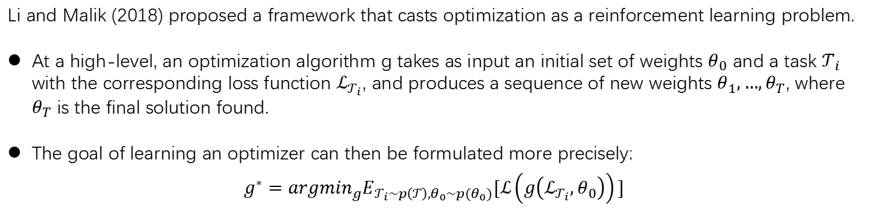
Reinforcement learning based optimizer
Li and Malik (2018) proposed a framework that casts optimization as a reinforcement learning problem.
At a high-level, an optimization algorithm g takes as input an initial set of weights $θ_{0}$ and a task $𝒯_{i}$ with the corresponding loss function $ℒ_{𝒯_{i}}$, and produces a sequence of new weights $θ_{1},…,θ_{T}$, where $θ_{T}$ is the final solution found.
The goal of learning an optimizer can then be formulated more precisely:
$$g^{∗}={argmin}_{g}E_{𝒯_{i}\sim p\left(𝒯\right),θ_{0}\sim p(θ_{0})}[ℒ\left(g\left(ℒ_{𝒯_{i}},θ_{0}\right)\right)]$$

Slide 36
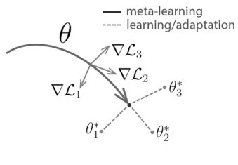
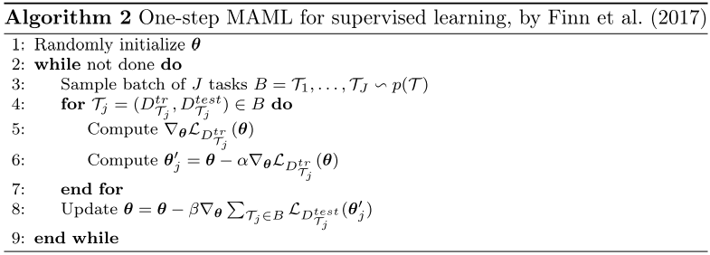
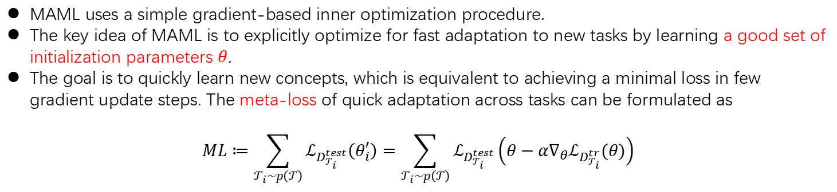
Model-agnostic meta-learning (MAML)
MAML uses a simple gradient-based inner optimization procedure.
The key idea of MAML is to explicitly optimize for fast adaptation to new tasks by learning a good set of initialization parameters $θ$.
The goal is to quickly learn new concepts, which is equivalent to achieving a minimal loss in few gradient update steps. The meta-loss of quick adaptation across tasks can be formulated as
$$ML≔\sum_{𝒯_{i}\sim p\left(𝒯\right)}{ℒ_{D_{𝒯_{i}}^{test}}\left(θ_{i}^{′}\right)}=\sum_{𝒯_{i}\sim p\left(𝒯\right)}{ℒ_{D_{𝒯_{i}}^{test}}\left(θ−α∇_{θ}ℒ_{D_{𝒯_{i}}^{tr}}(θ)\right)}$$

Slide 37
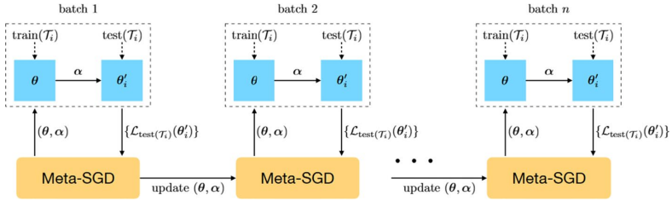
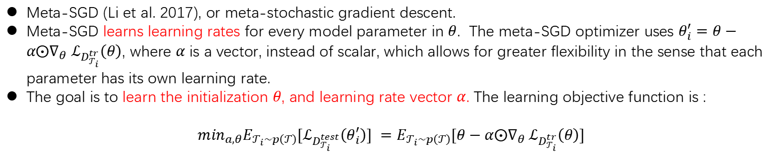
Meta‑SGD
Meta-SGD (Li et al. 2017), or meta-stochastic gradient descent.
Meta-SGD learns learning rates for every model parameter in $θ$. The meta-SGD optimizer uses $θ_{i}^{′}=θ−α⨀∇_{θ}$ $ℒ_{D_{𝒯_{i}}^{tr}}\left(θ\right)$, where $α$ is a vector, instead of scalar, which allows for greater flexibility in the sense that each parameter has its own learning rate.
The goal is to learn the initialization $θ$, and learning rate vector $α$. The learning objective function is :
$$\min_{a,θ}E_{𝒯_{i}\sim p\left(𝒯\right)}[ℒ_{D_{𝒯_{i}}^{test}}\left(θ_{i}^{′}\right)] =E_{𝒯_{i}\sim p\left(𝒯\right)}[θ−α⨀∇_{θ} ℒ_{D_{𝒯_{i}}^{tr}}\left(θ\right)]$$

Slide 38
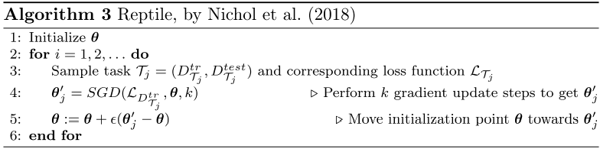
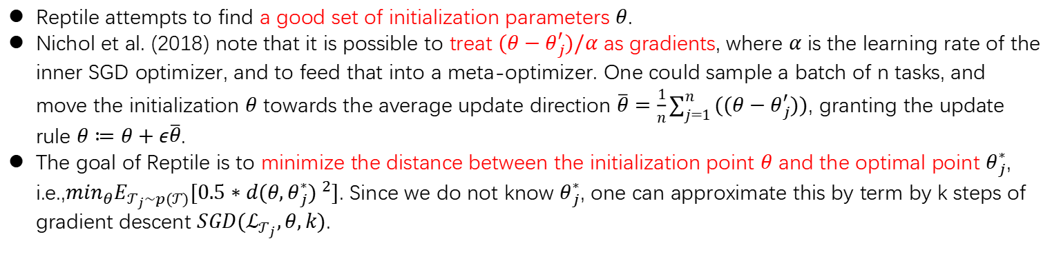
Reptile
Reptile attempts to find a good set of initialization parameters $θ$.
Nichol et al. (2018) note that it is possible to treat $(θ−θ_{j}^{′})/α$ as gradients, where $α$ is the learning rate of the inner SGD optimizer, and to feed that into a meta-optimizer. One could sample a batch of n tasks, and move the initialization $θ$ towards the average update direction $\overline{θ}=\frac{1}{n}\sum_{j=1}^{n}{((θ−θ_{j}^{′}))}$, granting the update rule $θ≔θ+ε\overline{θ}$.
The goal of Reptile is to minimize the distance between the initialization point $θ$ and the optimal point $θ_{j}^{∗}$, i.e.,$\min_{θ}E_{𝒯_{j}\sim p(𝒯)}[0.5∗{d(θ,θ_{j}^{∗}) }^{2}]$. Since we do not know $θ_{j}^{∗}$, one can approximate this by term by k steps of gradient descent $SGD(ℒ_{𝒯_{j}},θ,k)$.

Slide 39


Latent Embedding Optimization (LEO)-1
LEO learns a lower-dimensional latent embedding space, which indirectly allows us to learn a good set of initial parameters $θ$.
Given a task $𝒯_{j}$, the corresponding support set $D_{𝒯_{i}}^{tr}$ is fed into an encoder, which produces hidden codes for each example in that set. These hidden codes are paired and concatenated in every possible manner, granting us ${(Nk)}^{2}$ pairs, where N is the number of classes in the training set, and k the number of examples per class.
These paired codes are then fed into a relation network. The resulting embeddings are grouped by class, and parameterize a probability distribution over latent codes $z_{n}$ (for class n) in a low dimensional space $𝒵$. Let $x_{n}^{ℓ}$ denote the $ℓ$-th example of class n in $D_{𝒯_{i}}^{tr}$. Then, the mean $μ_{n}^{e}$ and variance $σ_{n}^{e}$ of a Gaussian distribution over latent codes for class n are computed as $μ_{n}^{e},σ_{n}^{e}=\frac{1}{{Nk}^{2}}\sum_{ℓ_{p}=1}^{k}{\sum_{m=1}^{N}{\sum_{ℓ_{q}=1}^{k}{g_{φ_{r}}(g_{φ_{e}}\left(x_{n}^{ℓ_{p}}\right),g_{φ_{e}}(x_{m}^{ℓ_{q}}))}}}$, where $g_{φ_{r}}$, $g_{φ_{e}}$ are parameters for the relation network and encoder respectively. Intuitively, the three summations ensure that every example with class n in $D_{𝒯_{i}}^{tr}$ is paired with every example from all classes n.

Slide 40

Latent Embedding Optimization (LEO)-2
The decoder can then generate a task-specific initialization $θ_{n}$ for class n. First, one computes a mean and variance for a Gaussian distribution using the latent code $μ_{n}^{d},σ_{n}^{d}=g_{φ_{d}}(z_{n})$. These are then used to sample initialization weights $θ_{n}\sim N(μ_{n}^{d}, diag(σ_{n}^{d2}))$.
The loss from the generated weights can then be propagated backwards to adjust the embedding space. In practice, generating such high-dimensional set of parameters from a low-dimensional embedding can be quite problematic. Therefore, LEO uses pre-trained models, and only generates weights for the final layer, which limits the expressivity of the model.

Slide 41



Learning Objective functions
Meta-learning via learned loss (ML³) learns optimize-independent loss functions to provide a strong learning signal for a variety of learning problems: $ℒ_{learned}=ℳ_{φ}(y, f_{θ}(x))$
The gradient of base-learner is $∇_{θ}ℒ_{learned}=∇_{θ}ℳ_{φ}(y, f_{θ}(x))/∇_{θ}f_{θ}(x)$, $θ_{new}= θ−α∇_{θ}ℒ_{learned}$. The objective function of meta-learner is $ℒ_{𝒯}={(y−f_{θ_{new}}(x))}^{2}$, and the gradient is computed with$∇_{φ}=∇_{f}ℒ_{𝒯}∇_{θ_{new}}f_{θ_{new}}∇_{φ}θ_{new}$.
In practice, updating the meta-parameters after each inner gradient update step works better. And the parameters of base learner would be reset after M inner gradient steps.

Slide 42




Learning Objective functions
Meta-Learning with Task-Adaptive Loss Function for Few-Shot Learning(MeTAL)
The base-learner was updated in the inner-loop with $θ_{i,j+1}=θ_{i,j}−α∇_{θ_{i,j}}ℒ_{φ}(τ_{i,j})$, where $τ_{i,j}$ denotes the task state for $𝒯_{i}$ at time-step $j$. They transform loss function parameters ϕ: $φ^{′}=γφ+β$. $γ$ and $β$ are the transformation parameters generated by the meta-learner $g(τ_{j};φ)$.
To train the meta-learning framework to generalize across different tasks, the outer-loop optimization is performed:
$$\left(θ,φ,φ\right)=\left(θ,φ,φ\right)−η∇_{\left(θ,φ,φ\right)}\sum_{𝒯_{i}}{ℒ(D_{i}^{Q};θ_{i})}$$

Slide 43

Genetic Loss Optimization(GLO)
GLO builds loss functions hierarchically from a set of operators and leaf nodes.
These functions are repeatedly recombined and mutated to find an optimal structure, and then a covariance-matrix adaptation evolutionary strategy (CMA-ES) is used to find optimal coefficients.
The optimal loss function was selected for having the highest validation accuracy out of the population.

Slide 44



Evolving Policy Gradients(EPG)
Learn a loss function $ℒ_{φ}$ that outperforms the usual policy gradient surrogate loss.
The learned loss function consists of temporal convolutions over the agent’s recent history.
The loss function parameters $φ$ are evolved through ES and the loss trains an agent’s policy $π_{θ}$ in an on-policy fashion via stochastic gradient descent.
The inner loop optimization problem is to minimize the loss $ℒ_{φ}$ with respect to the agent’s policy $π_{θ}$: $θ^{∗}={argmin}_{θ}E_{τ\sim M,π_{θ}}[ℒ_{φ}\left(π_{θ},τ\right)]$
The outer loop objective is to learn $ℒ_{φ}$ such that an agent’s policy $π_{θ^{∗}}$ trained with the loss function achieves high expected returns in the MDP distribution: $φ^{∗}={argmin}_{φ}E_{M\sim p(M)}E_{τ\sim M,π_{θ^{∗}}}[R_{τ}]$

Slide 45


Stochastic loss function(SLF)

Slide 46
optimization-based Conclusions
Optimization-based aim to learn new tasks quickly through (learned) optimization procedures.
Note that this closely resembles base-level learning, which also occurs through optimization (e.g., gradient descent).
In contrast to base-level techniques, optimization-based meta-learners can learn the optimizer and/or are exposed to multiple tasks, which allows them to learn to learn new tasks quickly.

Slide 47
References
[1] Koch G, Zemel R, Salakhutdinov R. Siamese neural networks for one-shot image recognition[C]//ICML deep learning workshop. 2015, 2: 0.
[2] Vinyals O, Blundell C, Lillicrap T, et al. Matching networks for one shot learning[J]. Advances in neural information processing systems, 2016, 29.
[3] Snell J, Swersky K, Zemel R. Prototypical networks for few-shot learning[J]. Advances in neural information processing systems, 2017, 30.
[4] Sung F, Yang Y, Zhang L, et al. Learning to compare: Relation network for few-shot learning[C]//Proceedings of the IEEE conference on computer vision and pattern recognition. 2018: 1199-1208.
[5] Shyam P, Gupta S, Dukkipati A. Attentive recurrent comparators[C]//International conference on machine learning. PMLR, 2017: 3173-3181.
[6] Duan Y, Schulman J, Chen X, et al. Rl $^ 2$: Fast reinforcement learning via slow reinforcement learning[J]. arXiv preprint arXiv:1611.02779, 2016.
[7] Wang J X, Kurth-Nelson Z, Tirumala D, et al. Learning to reinforcement learn[J]. arXiv preprint arXiv:1611.05763, 2016.
[8] Santoro A, Bartunov S, Botvinick M, et al. Meta-learning with memory-augmented neural networks[C]//International conference on machine learning. PMLR, 2016: 1842-1850.
[9] Munkhdalai T, Yu H. Meta networks[C]//International Conference on Machine Learning. PMLR, 2017: 2554-2563.

Slide 48
References
[10] Mishra N, Rohaninejad M, Chen X, et al. A simple neural attentive meta-learner[J]. arXiv preprint arXiv:1707.03141, 2017.
[11] Garnelo M, Rosenbaum D, Maddison C, et al. Conditional neural processes[C]//International Conference on Machine Learning. PMLR, 2018: 1704-1713.
[12] Edwards H, Storkey A. Towards a neural statistician[J]. arXiv preprint arXiv:1606.02185, 2016.
[12] Andrychowicz M, Denil M, Gomez S, et al. Learning to learn by gradient descent by gradient descent[J]. Advances in neural information processing systems, 2016, 29.
[13] Ravi S, Larochelle H. Optimization as a model for few-shot learning[J]. 2016.
[14] Li K, Malik J. Learning to optimize neural nets[J]. arXiv preprint arXiv:1703.00441, 2017.
[15] Finn C, Abbeel P, Levine S. Model-agnostic meta-learning for fast adaptation of deep networks[C]//International conference on machine learning. PMLR, 2017: 1126-1135.
[16] Rajeswaran A, Finn C, Kakade S M, et al. Meta-learning with implicit gradients[J]. Advances in neural information processing systems, 2019, 32.
[17] Li Z, Zhou F, Chen F, et al. Meta-sgd: Learning to learn quickly for few-shot learning[J]. arXiv preprint arXiv:1707.09835, 2017.
[18] Nichol A, Achiam J, Schulman J. On first-order meta-learning algorithms[J]. arXiv preprint arXiv:1803.02999, 2018.

Slide 49
References
[19] Rusu A A, Rao D, Sygnowski J, et al. Meta-Learning with Latent Embedding Optimization[C]//International Conference on Learning Representations. 2018.
[20] Bechtle S, Molchanov A, Chebotar Y, et al. Meta learning via learned loss[C]//2020 25th International Conference on Pattern Recognition (ICPR). IEEE, 2021: 4161-4168.
[21] Baik S, Choi J, Kim H, et al. Meta-Learning with Task-Adaptive Loss Function for Few-Shot Learning[C]//Proceedings of the IEEE/CVF International Conference on Computer Vision. 2021: 9465-9474.
[22] Gonzalez S, Miikkulainen R. Improved training speed, accuracy, and data utilization through loss function optimization[C]//2020 IEEE Congress on Evolutionary Computation (CEC). IEEE, 2020: 1-8.
[23] Houthooft R, Chen Y, Isola P, et al. Evolved policy gradients[J]. Advances in Neural Information Processing Systems, 2018, 31.
[24] Liu Q, Lai J. Stochastic loss function[C]//Proceedings of the AAAI Conference on Artificial Intelligence. 2020, 34(04): 4884-4891.

